Slide 1

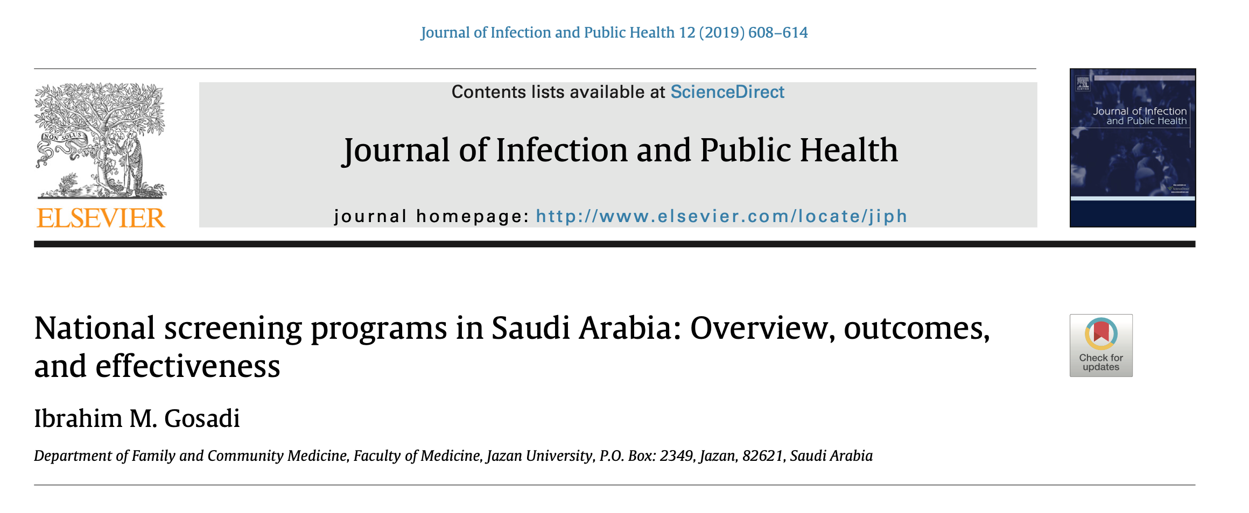
MEPH Journal Club
Presented by: Ghada Abozaid

Slide 2
Aim
To provide an overview of current governmental national screening programs in Saudi Arabia.
To provide a summary of available evidence concerning utilisation and outcomes of screening services in Saudi Arabia and factors influencing utilisation.
A brief comparison to other screening programs established in other countries is made.
Assessment of effectiveness of national screening programs in Saudi Arabia is briefed.

Slide 3

Vision 2030
2016
National Transformation Program
Considering assessment of factors influencing national prevalence of health risk factors.
Early detection of individuals at risk or asymptomatically suffering from chronic diseases.
24
Institutional Transformation & Health Care Model involves actions focusing on:
Diseases prevention
Strengthening the primary health care system.
96
strategic objectives of Vision 2030
Health Promotion against Health Risks
(Public Health System and Health Disasters Management)
Notes:
The new Institutional Transformation and Health Care Model, which is led by the Saudi Ministry of Health, in
Success of the new Health Care Model in Saudi Arabia is only possible when considering assessment of factors influencing national prevalence of health risk factors and early detection of chronic diseases.

Slide 4
Criteria used to assess the appropriateness of screening
The importance of health problems
Availability and acceptability of the screening test
Availability of adequate health services for confirmation of diagnosis and treatment.
The benefits of screening should outweigh risks.
1986, Wilson and Jungner
Notes:
These criteria were related to

Slide 5
Criteria used to assess the appropriateness of screening
Provision of evidence of effectiveness of screening programs
Integration of education, testing, clinical services
Ensuring equity and access to screening for the targeted population.
Andermann et al
Notes:
With advancement of screening tools, especially with regards to genetic testing, these criteria have been revisited by Andermann et al. to suggest more specific criteria

Slide 6
Initiation of nationwide screening programs
Prevalence of diseases.
Social and economic burden.
Availability of a competent health system ensuring effective application of the screening programs.
Notes:
Prevalence of diseases and risk factors vary between populations and countries.
can be justified by

Slide 7


National Screening Programs in Saudi Arabia
Sickle cell disease
Thalassemia
HIV
Hepatitis B & C
2004
Premarital screening program
131
Inborn error of metabolism
Endocrine disorders
2005
National newborn screening program
183
Notes:
(currently called Healthy Marriage Program) involves screening individuals intending to get married,
131 centers in MOH hospitals
epidemiological situation of hemoglobinopathies in Saudi Arabia was the review by El-Hazmi, published in 2004
endemicity of malaria aided in increasing prevalence of hemoglobinopathies, such as sickle cell disease and thalassemia in certain regions in the country. With the advancement of transportation systems, movement of Saudi citizens to other regions in the country facilitated spread of these blood disorders all over the kingdom, mandating establishment of a national screening program for hemoglobinopathies
Three studies were found where screening for congenital anomalies and inborn error of metabolism was performed for newborns between 1980 and 1999 [16–18]. The findings of these investigations recommended establishment of a Saudi newborn screening program.
all newborns within 24–72 h of delivery,
183 hospitals all over the kingdom [8]. Upon its establishment,

Slide 8
National Newborn Screening Committee Responsibility
Overseeing
Planning
Monitoring
Evaluation of the program
Selection of diseases to be screened.
Notes:
Saudi Ministry of Health formed a National Newborn Screening Committee

Slide 9

National Screening Programs in Saudi Arabia
Sickle cell disease
Thalassemia
HIV
Hepatitis B & C
2004
Premarital screening program
131
Inborn error of metabolism
Endocrine disorders
2005
National newborn screening program
183
2016
Hearing-loss
Critical congenital heart defects
30
Notes:
(currently called Healthy Marriage Program) involves screening individuals intending to get married,
131 centers in MOH hospitals
epidemiological situation of hemoglobinopathies in Saudi Arabia was the review by El-Hazmi, published in 2004
endemicity of malaria aided in increasing prevalence of hemoglobinopathies, such as sickle cell disease and thalassemia in certain regions in the country. With the advancement of transportation systems, movement of Saudi citizens to other regions in the country facilitated spread of these blood disorders all over the kingdom, mandating establishment of a national screening program for hemoglobinopathies
Three studies were found where screening for congenital anomalies and inborn error of metabolism was performed for newborns between 1980 and 1999 [16–18]. The findings of these investigations recommended establishment of a Saudi newborn screening program.
all newborns within 24–72 h of delivery,
183 hospitals all over the kingdom [8]. Upon its establishment,

Slide 10
Workflow of the Saudi newborn screening program
Repeat of screening tests for initially positive results.
Confirmation using biochemical testing.
Referral system to specialised hospitals for management plan initiation.
Notes:
Saudi Ministry of Health formed a National Newborn Screening Committee

Slide 11


Outcomes of Saudi newborn screening program
743 cases
139
775,000
Congenital hypothyroidism
Congenital adrenal hyperplasia
Propionic acidaemia.
(2005 - 2012)
Notes:
2017 published comprehensive retrospective study
reported findings
A total of 743 cases: were detected where most frequently reported cases
According to Alfadhel et al. the incidence of newborn errors is one of the highest in the globe and this high incidence can be justified by the high rate of consanguineous marriages in Saudi Arabia.
In addition to the high rate of consanguinity, Alfadhel et al. indicated the importance of provision of infrastructures, training, and public awareness to ensure continuity and success of the program

Slide 12

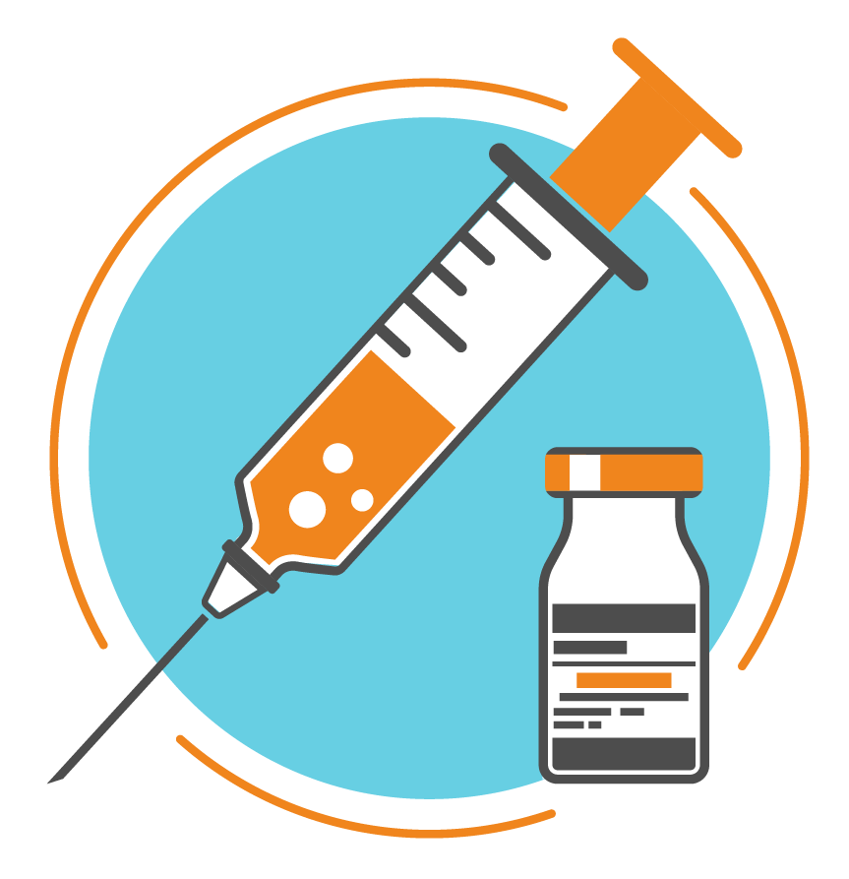
Premarital Screening Programs in Saudi Arabia
Premarital screening program
+ ve Risky Couples
- ve
Sickle cell disease & Thalassemia
One of a screened couple were found to be affected with hepatitis B, C, or HIV
Education about risk & the health complications experienced among affected children
Other spouse-to- be would be informed about the infection, & then requested to revisit the decision to proceed with marriage
Notes:
(currently called Healthy Marriage Program) involves screening individuals intending to get married,
Healthy partner would be transferred to a preventive medicine clinic for further evaluation & vaccination with HBV
According to the current procedures following detecting subjects affected or carriers of these conditions, marriage of risky couples is not prevented,
the current practice guidance concerning detecting a partner affected with hepatitis C or HIV is not clear and the recommended guidance is referral to a preventive medicine clinic at the hospital for further consideratio

Slide 13
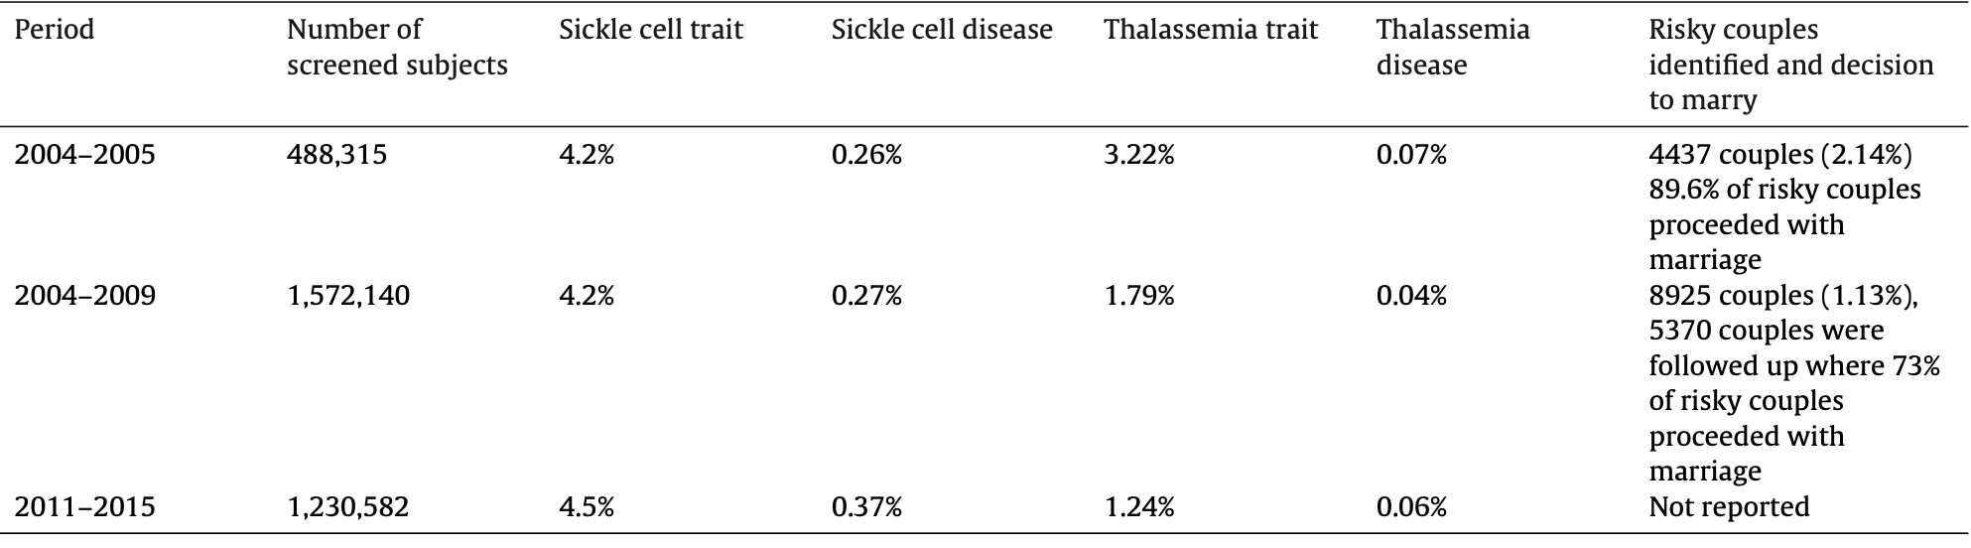
Outcomes of Premarital Screening Program in Saudi Arabia
Notes:
In 2007, Alhamdan et al.
in 2010, Al Sulaiman et al, 129 couples (98% of risky couple proceed with marriage. cultural pressure was on one of the main reasons behind rejecting the counselling advice
reduction of proportions of risky couples who proceeded with marriage from about 90% by the end of 2005 to 73% by end of 2009
reduction of proportion of identified risky couples from 2.14% by the end of 2005 to 1.13% by the end of 2009
2011
2018
All have gap between study and publication

Slide 14
International screening programs

Slide 15
 | SA | Australia | New Zealand | Netherland | UK | US | Singapore
Breast Screening Program | - | ✓ | ✓ | ✓ | ✓ | ✓ | ✓
Cervical Screening Program | - | ✓ | ✓ | ✓ | ✓ | ✓ | ✓
Bowel Cancer Screening Program | - | ✓ | ✓ | ✓ | ✓ | - | colorectal
Newborn Bloodspot Screening | Newborn Screening | ✓ | Metabolic Screening | ✓ | ✓ | Newborn screening | Newborn screening
Newborn Hearing Screening | * | ✓ | - | ✓ | ✓ | - | -
Premarital Screening Program | ✓ | - | - | - | - | - | -
Abdominal aortic aneurysm | - | - | - | - | ✓ | - | -
Diabetes mellitus | - | - | - | - | Diabetic eye screening | - | ✓
Fetal anomaly screening | - | - | - | Screening for Down’s, Edwards’ and Patau’s syndromes in pregnancy | ✓ | - | -
Infectious diseases in pregnancy screening | - | - | - | Antenatal screening for infectious diseases and erythrocyte sensitisation | ✓ | - | -
Newborn and infant physical examination | - | - | - | - | ✓ | - | -
Sickle cell and thalassaemia (SCT) screening | Newborn Screening |  |  | - | ✓ | - | -
Obesity | - | - | - | - | - | - | ✓
Hypertension | - | - | - | - | - | - | ✓
Hyperlibidemia. | - | - | - | - | - | - | ✓

Slide 16
Prevalent disease in Saudi Arabia
Common types of Cancer | Prevelance
Breast cancer | (28.7%) / 6264 females
Colorectal cancer | (14.2%) / 5299 males
Thyroid cancer
Non-Hodgking lymphoma
Leukemia
Saudi Cancer Registry, 2014
In 2015, the Saudi Centre for Evidence-Based Healthcare assembled a panel of experts for development of National Guidelines for Colorectal Cancer Screening in Saudi Arabia where the panel recommended establishment of a colorectal screening program targeting asymptomatic patients at average risk of the disease
A national campaign to raise awareness about early screening for breast cancer was initiated by the Saudi MOH in 2015 as a promotion for the National Program for Early detection for Breast Cancer
Notes:
he process of seeking screening for breast cancer is not clear,
2015 El Bcheraoui et al. reported that among 1135 women who were aged 50 and older, 92% of them reported never having a mammogram The low participation rate can be partially explained by extreme lack of information concerning available screening services for breast cancer.

Slide 17
Prevalent disease in Saudi Arabia
In 2013, Saudi Ministry of Health published the findings of the Saudi Health Interview Survey (10,827 Saudi)
Blood test | Condition | Prevalence | Finding
Blood pressure | Pre- hypertension | 40.5% | 1089 participants were reported as undiagnosed cases of hypertension
Blood cholesterol | pre-hypercholestrolemia | 20% | 360 participants were found to have undiagnosed hypercholesterolemia
Blood glucose | pre-diabetes | 16.3% | 389 participants were detected as undiagnosed diabetes cases
Notes:
In 2013, Saudi Ministry of Health published the findings of the Saudi Health Interview Survey. This was a house-hold survey covering all administrative regions in the kingdom involving a sample of 10,827 where data concerning,, and were collected. According to the survey, prevalence

Slide 18
Prevalent disease in Saudi Arabia
73% mortality of Saudis due to noncommunicable disease
>1/3 mortalities are attributed to cardiovascular diseases
WHO, 2019
Notes:
According to the World Health Organization, non- communicable disease accounts for 73% of mortality of Saudis where more than one third of mortalities are attributed to cardio- vascular diseases [31]. Obesity, raised blood pressure, and diabetes are main risk factors for development of cardiovascular diseases among Saudis. Despite increased prevalence and high health and economic burden, screening policy for these risk factors among Saudis is currently not available and only public awareness days are organized on yearly basi
Obesity, raised blood pressure, and diabetes are main risk factors for development of cardiovascular diseases among Saudis.

Slide 19

The Crown Health Project (CHP), 2008
Aim:
Prevention of non-communicable diseases (NCDs)
Notes:
the Saudi MOH launched a small scale community- based interventional program called (The Crown Health Project) in Al-Jouf region.

Slide 20
The Crown Health Project (CHP), 2008
Objectives :
To determine the prevalence of NCDs & their risk factors
To raise awareness regarding risk factors for NCDs and preventive measures among the public
To improve the early detection & management of NCDs
To improve diagnostic, curative, & rehabilitative services for patients.
Notes:
the Saudi MOH launched a small scale community- based interventional program called (The Crown Health Project) in Al-Jouf region.

Slide 21
The Crown Health Project, 2008
Procedure:
Screening for risk factors related to:
Lifestyle
Medical history
Physical and biochemical measurements
Notes:
the Saudi MOH launched a small scale community- based interventional program called (The Crown Health Project) in Al-Jouf region.

Slide 22
The Crown Health Project, 2008
Lessons drawn from this project:
The implementation of the project is considered to be feasible in light of the high interest of the administrative and political leaders of the region, community leaders& other stakeholders
2) It is important to establish good relationships with community leaders for the promotion of the project by engaging them.
3) To ensure the timely implementation of activities & to retain trained staff, it is necessary to maintain continuous financial support for the entire duration of the project.
Notes:
the Saudi MOH launched a small scale community- based interventional program called (The Crown Health Project) in Al-Jouf region.

Slide 23
Limitation the screening program effectiveness
Inability to identify and invite targeted population.
Limited participation of targeted subjects.
Lack of infrastructures to diagnosis and treat detected cases.

Slide 24
Effectiveness of national Saudi screening programs
Measuring the effectiveness of a screening program in terms of observing how screening modifies subsequent outcomes of the diseases of interest in screened communities.
Establishment of counselling clinics.
Notes:
feasibility, access and cost of screening programs
he effectiveness of premarital screening is evident by reduction of proportions of risky couples who proceeded with marriage from about 90% by the end of 2005 to 73% by end of 2009
Establishment of counselling clinics is an important contributor in this reduction aiding in increased awareness of risky couples and enabling making an informed-decision.

Slide 25
Recommendation
Further researches to investigate the current trend in cancellation or completion of of risky marriage.
Increase public awareness days for noncommunicable diseases.
Establish a governmental registry database for national screening programs, noncommunicable diseases in both languages.

Slide 26



